Slide 1
Java 8 Lambda Expressions
momedaram

Slide 2
What is Lambda Expressions?
Lambda Expressions are methods without names. i.e., anonymous functions.
Like methods, they can have Parameters ,Body ,Return type and Possible list of exceptions that can be thrown.
Unlike methods, they won’t have names and they are not associated with any class.
(Parameters) -> Expression ;
Or
(Parameters) -> { Statements };

Slide 3
Why Lambda Expressions?
Lambda expression(s) is used to provide the implementation for functional interface.
Functional interface is an interface which has only one abstract method and can have any number of default methods.
EX: Comparator, Runnable And ActionListener.
int compare(T o1, T o2);
public abstract void run();
public void actionPerformed(ActionEvent e);

Slide 4
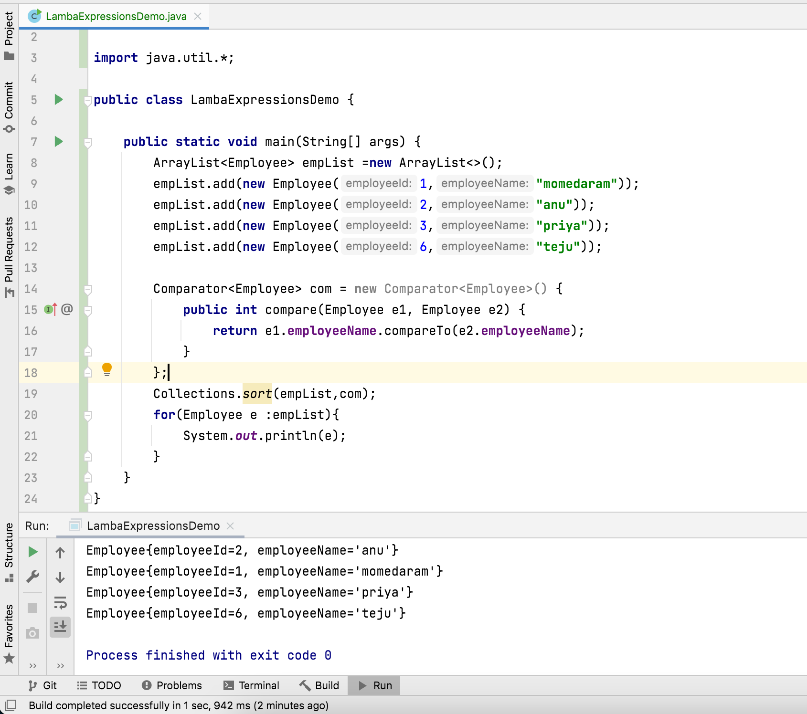
Before Java 8: Implementation of Comparator interface using anonymous inner class

Slide 5
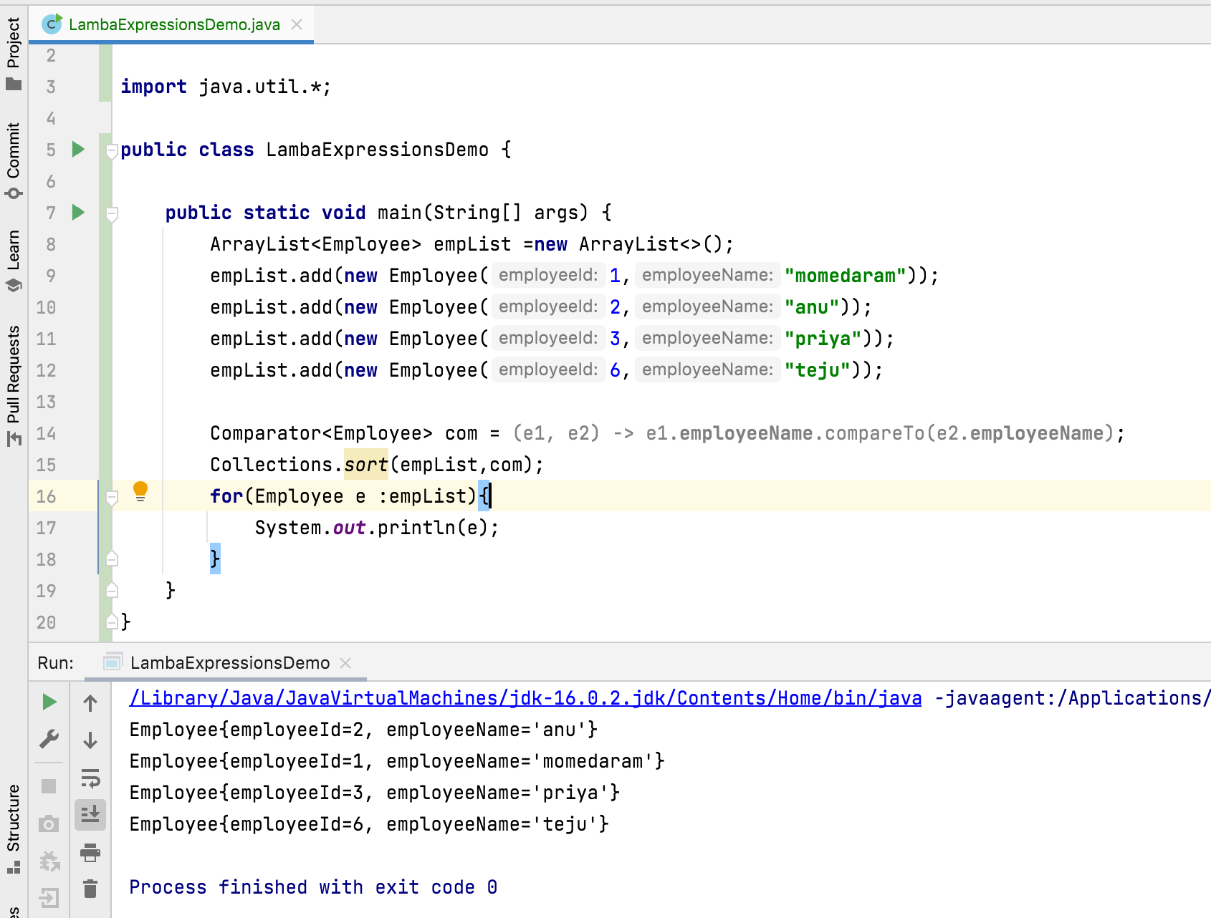
After Java 8 : Implementation of Comparator interface using lambda expressions

Slide 6
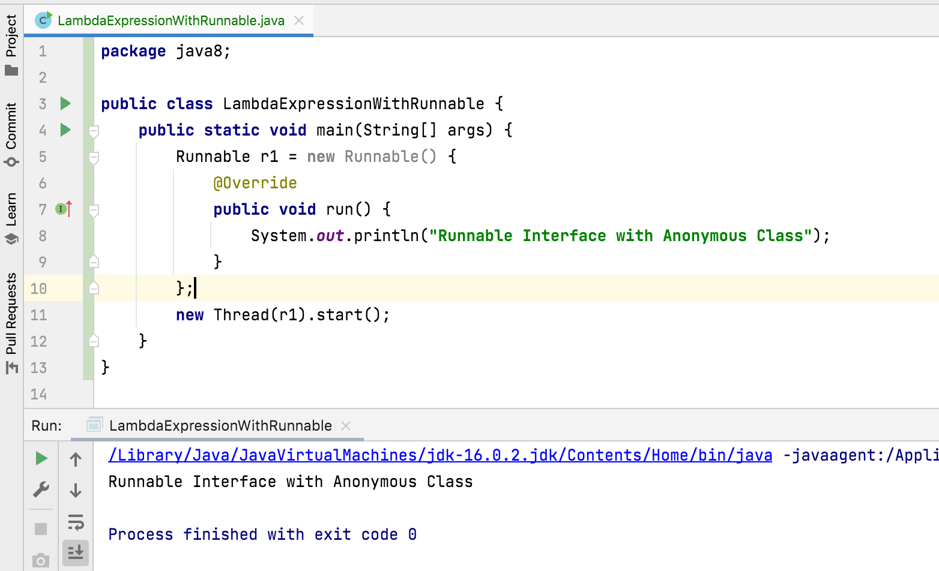
Before Java 8 : Implementation of Runnable interface using anonymous inner class

Slide 7
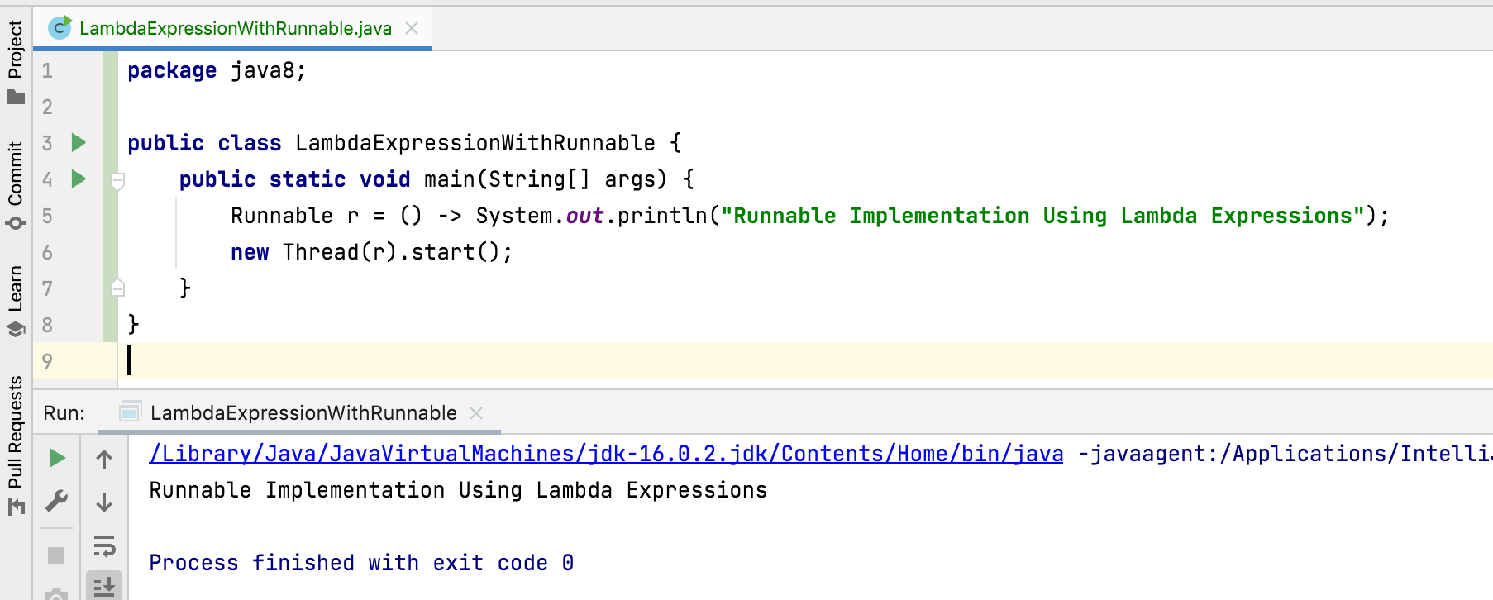
After Java 8 : Implementation of Runnable interface using lambda expressions

Slide 8
Benefits Of Lambda Expressions
Lambda expressions allows to write more clear, concise and flexible code.
Lambda expressions removes verbosity and repetition of code.

Slide 9
Thank You!
momedaram

